Slide 1
Chapter 5
Effects of Inflation

Slide 2
LEARNING OUTCOMES
Understand inflation/deflation
Calculate PW of cash flows with inflation
Calculate FW with inflation considered

Slide 3
Understanding Inflation
Inflation
A sustained increase in the general price level
Increase in price of goods and services
Increase in amount of money needed to purchase same amount of goods or services.
Inflation results in a decrease in purchasing power of money, i.e., one unit of money buys less goods or services
Inflation makes future dollars less valuable than present dollars.

Slide 4
Understanding Inflation
Inflation
Because of inflation, dollars in one period of time are not equivalent to dollars in another.
We know that engineering economic analysis requires that comparisons be made on an equivalent basis.
So, it is important for us to be able to incorporate the effects of inflation.

Slide 5
Understanding Inflation
Deflation
When the purchasing power of a monetary unit increases rather than decreases as time passes, the result is deflation.
Deflation, very rare in the modern world, nonetheless can exist.
Deflation has the opposite effect of inflation—one can buy more with money in future years than can be bought today.
Thus, deflation makes future dollars more valuable than current dollars.

Slide 6
How Does Inflation Happen?
Economists generally believe that inflation depends on the following, either in isolation or in combination.
Money supply
The amount of money in our national economy has an effect on its purchasing power. If there is too much money in the system (the Federal Reserve controls the flow of money) versus goods and services to purchase with that money, the value of dollars tends to decrease. When there are fewer dollars in the system, they become more valuable. The Federal Reserve seeks to increase the volume of money in the system at the same rate that the economy is growing.

Slide 7
How Does Inflation Happen?
Economists generally believe that inflation depends on the following, either in isolation or in combination.
Exchange rates
The strength of the dollar in world markets affects the profitability of international companies. Prices may be adjusted to compensate for the dollar’s relative strength or weakness in the world market. As corporations’ profits are weakened or eliminated in some markets owing to fluctuations in exchange rates, prices may be raised in other markets to compensate.

Slide 8
How Does Inflation Happen?
Economists generally believe that inflation depends on the following, either in isolation or in combination.
Cost–push
This cause of inflation develops as producers of goods and services “push” their increasing operating costs along to the customer through higher prices.
These operating costs include fabrication/manufacturing, marketing, and sales

Slide 9
How Does Inflation Happen?
Economists generally believe that inflation depends on the following, either in isolation or in combination.
Demand–pull
This cause is realized when consumers spend money freely on goods and services. As more and more people demand certain goods and services, the prices of those goods and services will rise (demand exceeding supply).

Slide 10
Considering Inflation in Engineering Economy
Actual vs Constant Dollars
To introduce the effect of inflation into our economic analysis, we need to define several inflation-related terms:
Actual (current, nominal) dollars
Out-of-pocket dollars paid at the time of purchasing goods and services. Actual dollars are estimates of future cash flows for year n that take into account any anticipated changes in amounts caused by inflationary or deflationary effects.

Slide 11
Considering Inflation in Engineering Economy
Constant (real) dollars
Dollars in some base year used to adjust for the effects of inflation.
Constant dollars represent constant purchasing power that is independent of the passage of time.
In situations where inflationary effects were assumed when cash flows were estimated, the estimates obtained can be converted to constant dollars (base-year dollars) by adjustment with some readily accepted general inflation rate.
We will assume that the base year is always time 0, unless we specify otherwise.

Slide 12
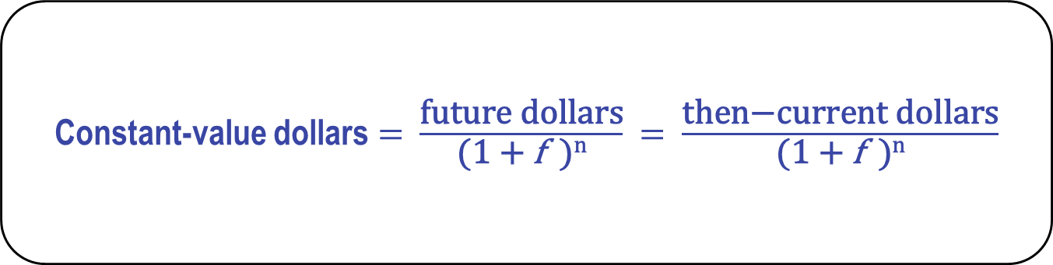
Understanding Inflation
Ways to work problems when considering inflation:
Constant-value dollars $=$ $\frac{\text{future} \text{dollars}}{\text{(1} \text{+} \text{f} \text{)}\text{n}}$ $=$ $\frac{\text{then}\text{−}\text{current} \text{dollars}}{\text{(1} \text{+ }\text{f} \text{)}\text{n}}$
Discounting current dollars by the amount of inflation

Slide 13
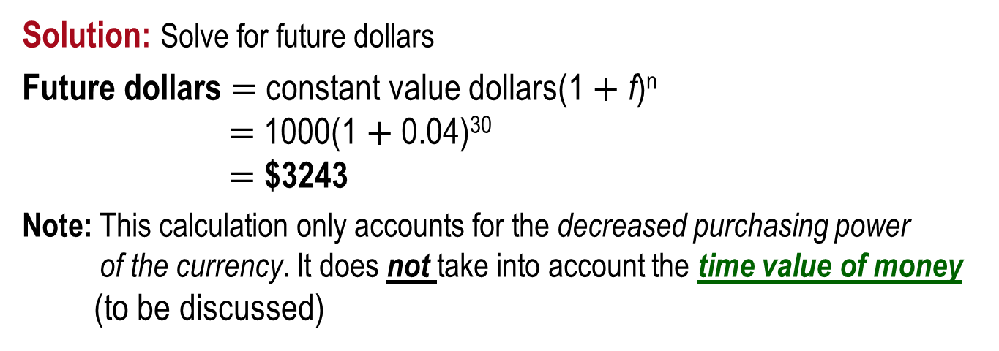
Example: Constant Value Dollars
How much would be required today to purchase an item that increased in cost by exactly the inflation rate? The cost 30 years ago was $1000 and inflation has consistently averaged 4% per year.
Solution: Solve for future dollars
Future dollars $=$ constant value dollars(1 $+$ f)^{n} $=$ 1000(1 $+$ 0.04)³⁰ $=$ $3243
Note: This calculation only accounts for the decreased purchasing power of the currency. It does not take into account the time value of money (to be discussed)

Slide 14
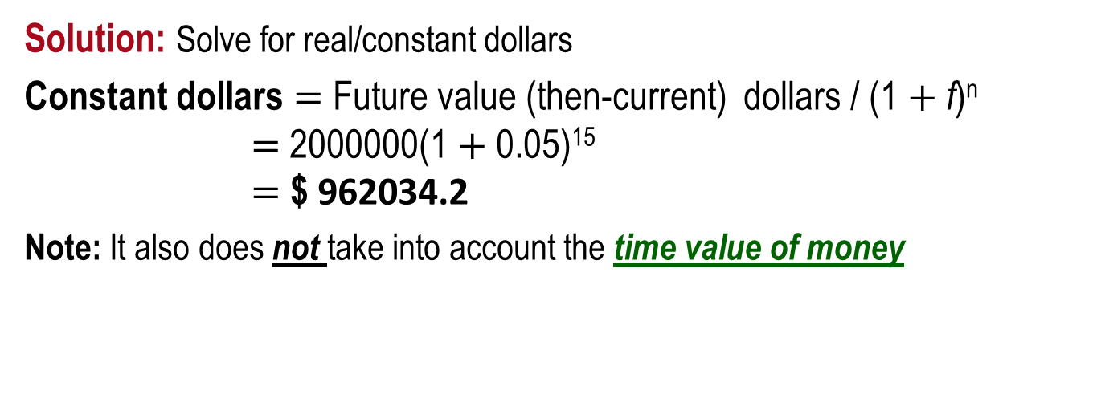
Example: Constant Value Dollars
The cost of repairing a tank in 15 years is expected to be $2000000. If inflation is assumed to be 5% per year, what is the cost of replacing the tank 15 years from now in real (today’s) dollars?
Solution: Solve for real/constant dollars
Constant dollars $=$ Future value (then-current) dollars / (1 $+$ f)^{n} $=$ 2000000(1 $+$ 0.05)¹⁵ $=$ $ 962034.2
Note: It also does not take into account the time value of money
This problems tells that the amount of current dollars 15 years from now that this equipment will cost is 2 million dollars.

Slide 15
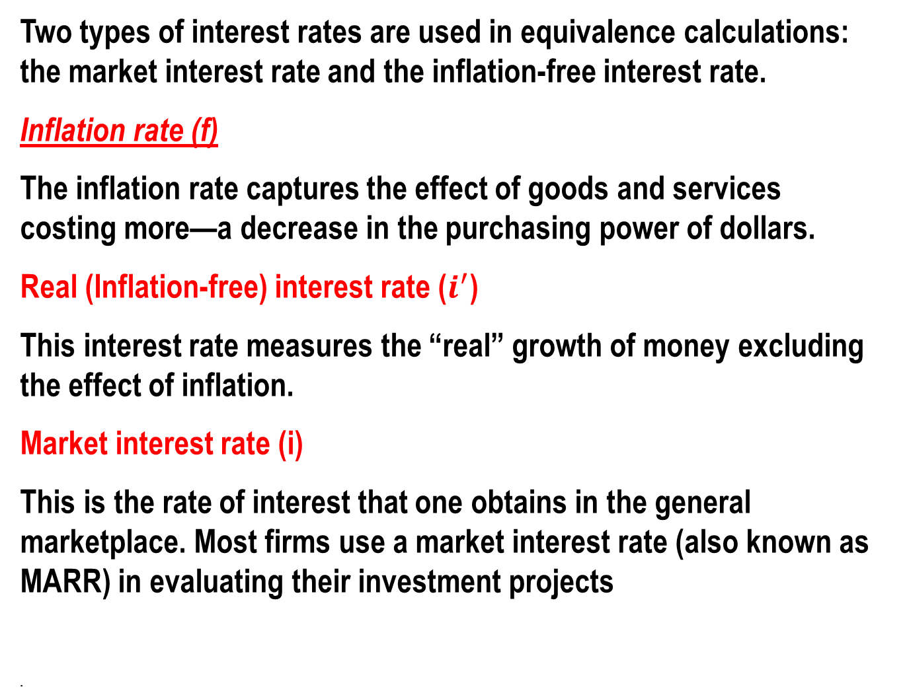
Equivalence Calculation under Inflation
Two types of interest rates are used in equivalence calculations: the market interest rate and the inflation-free interest rate.
Inflation rate (f)
The inflation rate captures the effect of goods and services costing more—a decrease in the purchasing power of dollars.
Real (Inflation-free) interest rate ($i^{′}$)
This interest rate measures the “real” growth of money excluding the effect of inflation.
Market interest rate (i)
This is the rate of interest that one obtains in the general marketplace. Most firms use a market interest rate (also known as MARR) in evaluating their investment projects
.

Slide 16

Equivalence Calculation under Inflation
The mathematical relationship between the inflation, real and market interest rates is given as
.

Slide 17
Relationship between the inflation, real and market interest rates
Think about some dollar amount of money = $M
How much $M will be worth let’s say one year from now = $M(1+i)
However if inflation is occurring, then the buying power of M dollar will decrease and decrease by the rate of inflation.

Slide 18
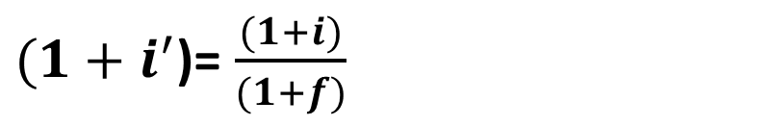
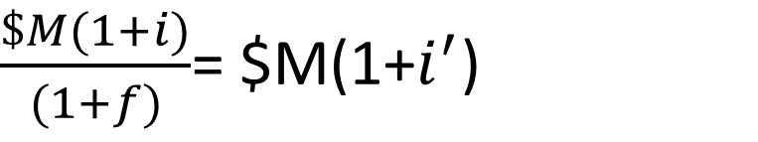
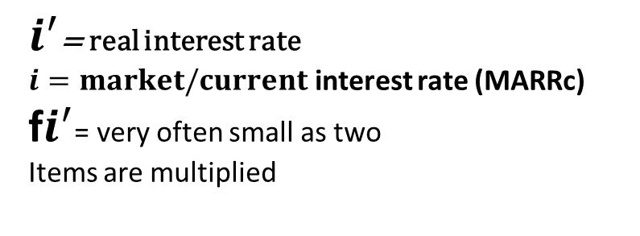
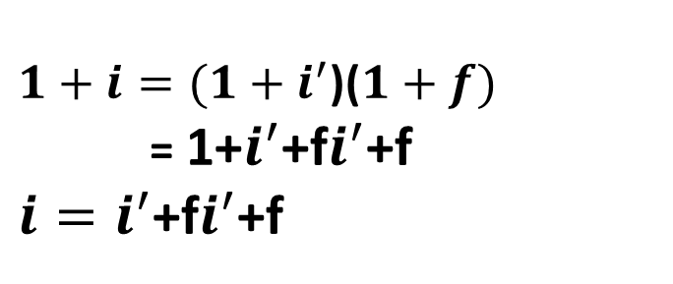
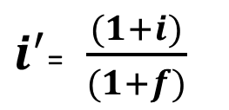
Relationship between the inflation, real and market interest rates
$\frac{\$M(1+i)}{(1+f)}$= $M(1+$i^{′}$)
${(1+i}^{′}$)= $\frac{(1+i)}{(1+f)}$
$i^{′}$= $\frac{(1+i)}{(1+f)}$
-1
$1+i=(1+i^{′}$)($1+f)$
= 1+$i^{′}$+f$i^{′}$+f
$i=i^{′}$+f$i^{′}$+f
$i^{′}$= real interest rate
$i=market/current$ interest rate (MARRc)
f$i^{′}$= very often small as two
Items are multiplied

Slide 19
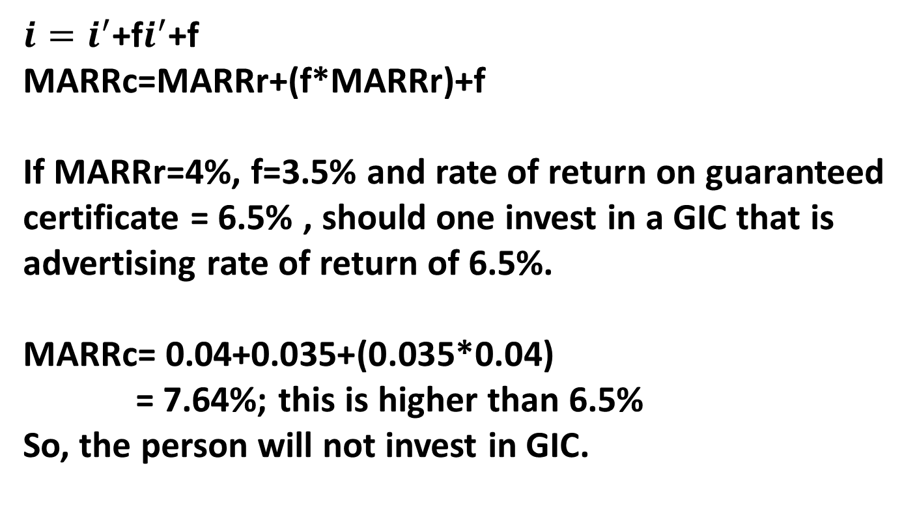
Application of the inflation, real and market interest rates
$i=i^{′}$+f$i^{′}$+f
MARRc=MARRr+(f*MARRr)+f
If MARRr=4%, f=3.5% and rate of return on guaranteed certificate = 6.5% , should one invest in a GIC that is advertising rate of return of 6.5%.
MARRc= 0.04+0.035+(0.035*0.04)
= 7.64%; this is higher than 6.5%
So, the person will not invest in GIC.

Slide 20

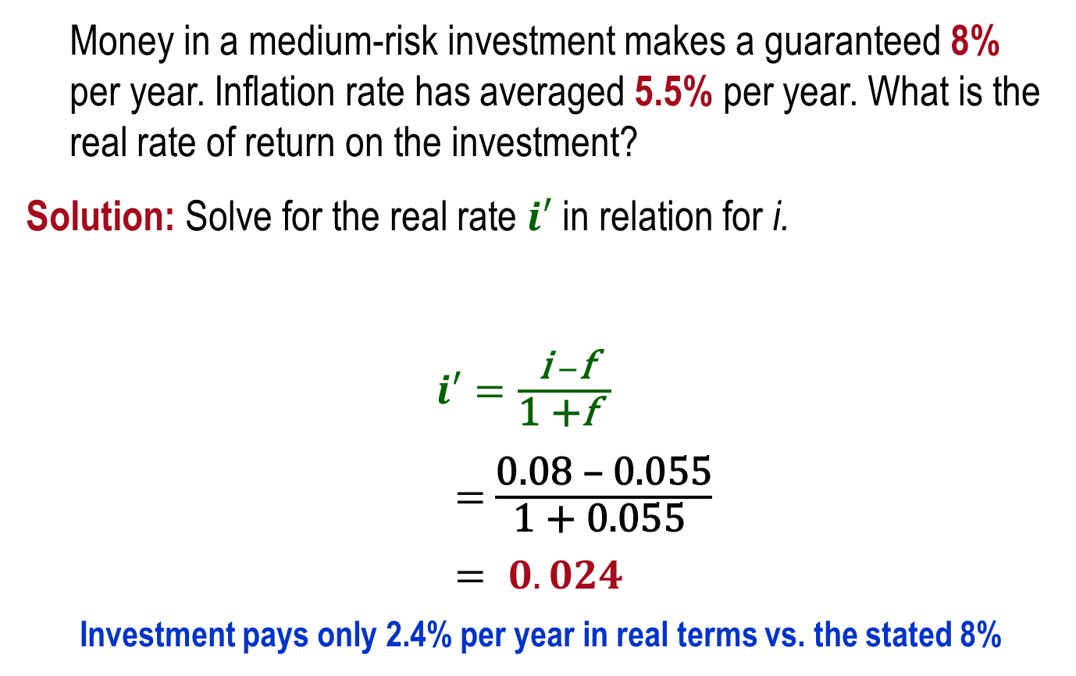
Example: Market vs. Real Rate
Money in a medium-risk investment makes a guaranteed 8% per year. Inflation rate has averaged 5.5% per year. What is the real rate of return on the investment?
Solution: Solve for the real rate $i′$in relation for i.
$i′=\frac{\text{i} −\text{f}}{\text{1 +}\text{f} }$
$=$ $\frac{\text{0.08 – 0.055}}{\text{1 + 0.055 }}$
$= 0.024$
Investment pays only 2.4% per year in real terms vs. the stated 8%

Slide 21
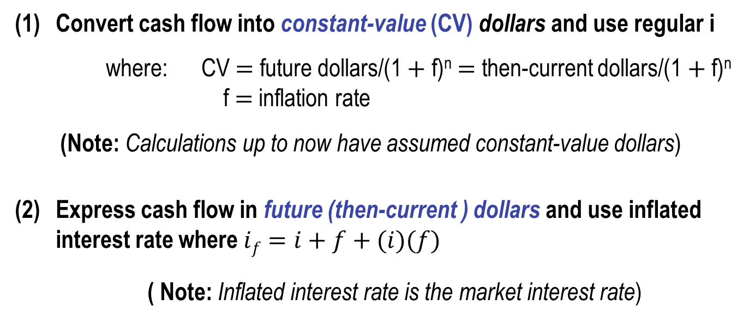
PW Calculations with Inflation
Two ways to account for inflation in PW calculations
(1) Convert cash flow into constant-value (CV) dollars and use regular i
where: CV $=$ future dollars/(1 $+$ f)^{n} $=$ then-current dollars/(1 $+$ f)^{n} f $=$ inflation rate
(Note: Calculations up to now have assumed constant-value dollars)
(2) Express cash flow in future (then-current ) dollars and use inflated interest rate where $if=i+f+(i)(f)$
( Note: Inflated interest rate is the market interest rate)

Slide 22
End of this chapter

Slide 23
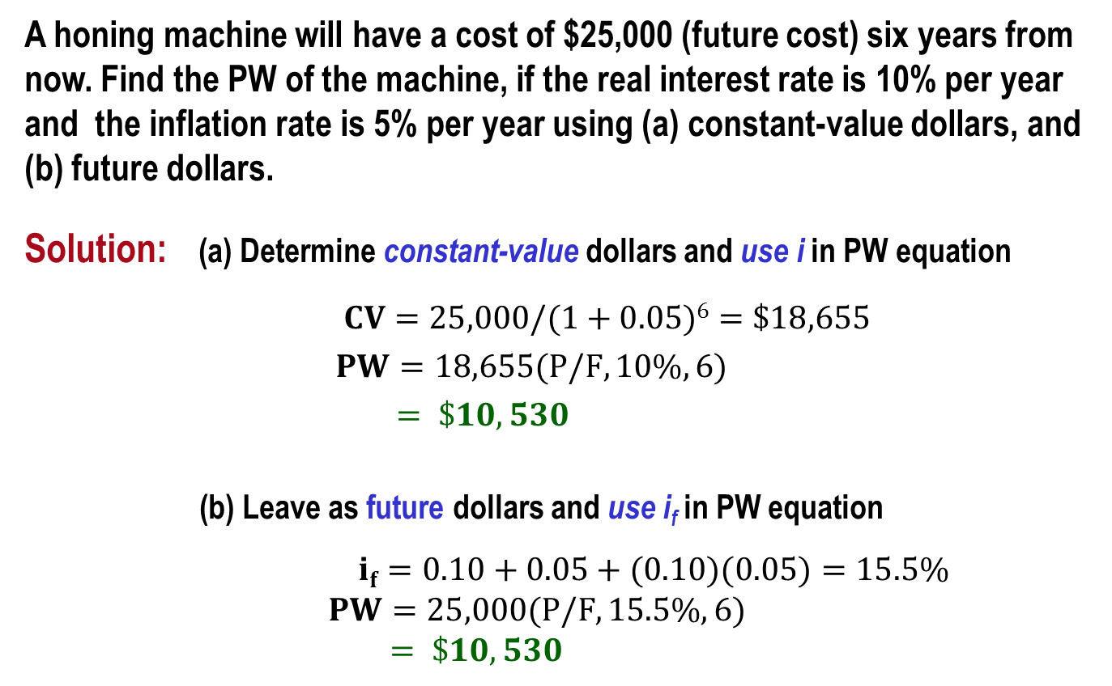
Example: PW with Inflation
A honing machine will have a cost of $25,000 (future cost) six years from now. Find the PW of the machine, if the real interest rate is 10% per year and the inflation rate is 5% per year using (a) constant-value dollars, and (b) future dollars.
Solution: (a) Determine constant-value dollars and use i in PW equation
$CV=25,000/(1+0.05)6=\$18,655$ $PW=18,655(P/F,10\%,6)$ $= \$10,530$
(b) Leave as future dollars and use i_{f} in PW equation
$if=0.10+0.05+(0.10)(0.05)=15.5\%$ $PW=25,000(P/F,15.5\%,6)$ $= \$10,530$

Slide 24
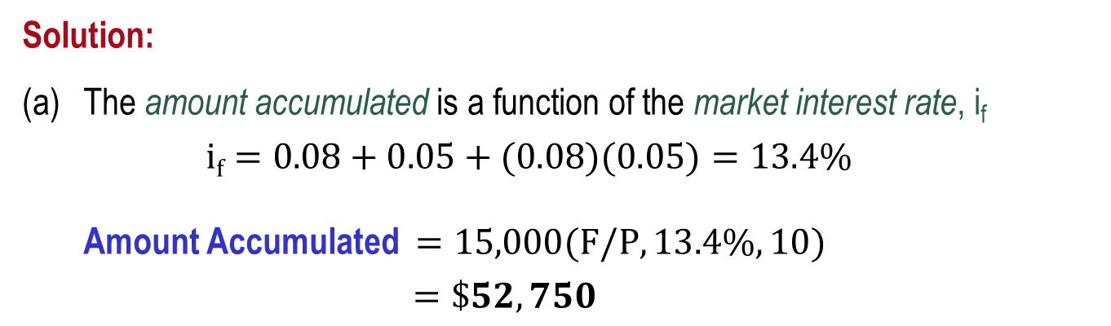
Example: FW with Inflation (1)
An engineer invests $15,000 in a savings account that pays interest at a real 8% per year. If the inflation rate is 5% per year, determine (a) the amount of money that will be accumulated in 10 years, (b) the purchasing power of the accumulated amount (in terms of today’s dollars), (c) the number of future dollars that will have the same purchasing power as the $15,000 today, and (d) the amount to maintain purchasing power and earn a real 8% per year return.
Solution:
The amount accumulated is a function of the market interest rate, i_{f}
$if=0.08+0.05+(0.08)(0.05)=13.4\%$
Amount Accumulated $=15,000(F/P,13.4\%,10)$
$=\$52,750$

Slide 25



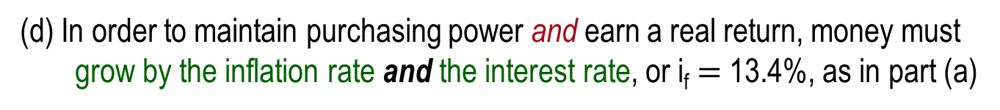
Example: FW with Inflation (2)
(b) To find the purchasing power of the accumulated amount deflate the inflated dollars
Purchasing power $=15,000(F/P,13.4\%,10)/(1+0.05)10$
$= \$32,384$
(c) The number of future dollars required to purchase goods that cost $15,000 now is the inflated cost of the goods
Number of future dollars $=15,000(F/P,5\%,10)$
$= \$24,434$
(d) In order to maintain purchasing power and earn a real return, money must grow by the inflation rate and the interest rate, or i_{f} $=$ 13.4%, as in part (a)
$FW=15,000(F/P,13.4\%,10)$
$= \$52,750$

